Slide 1
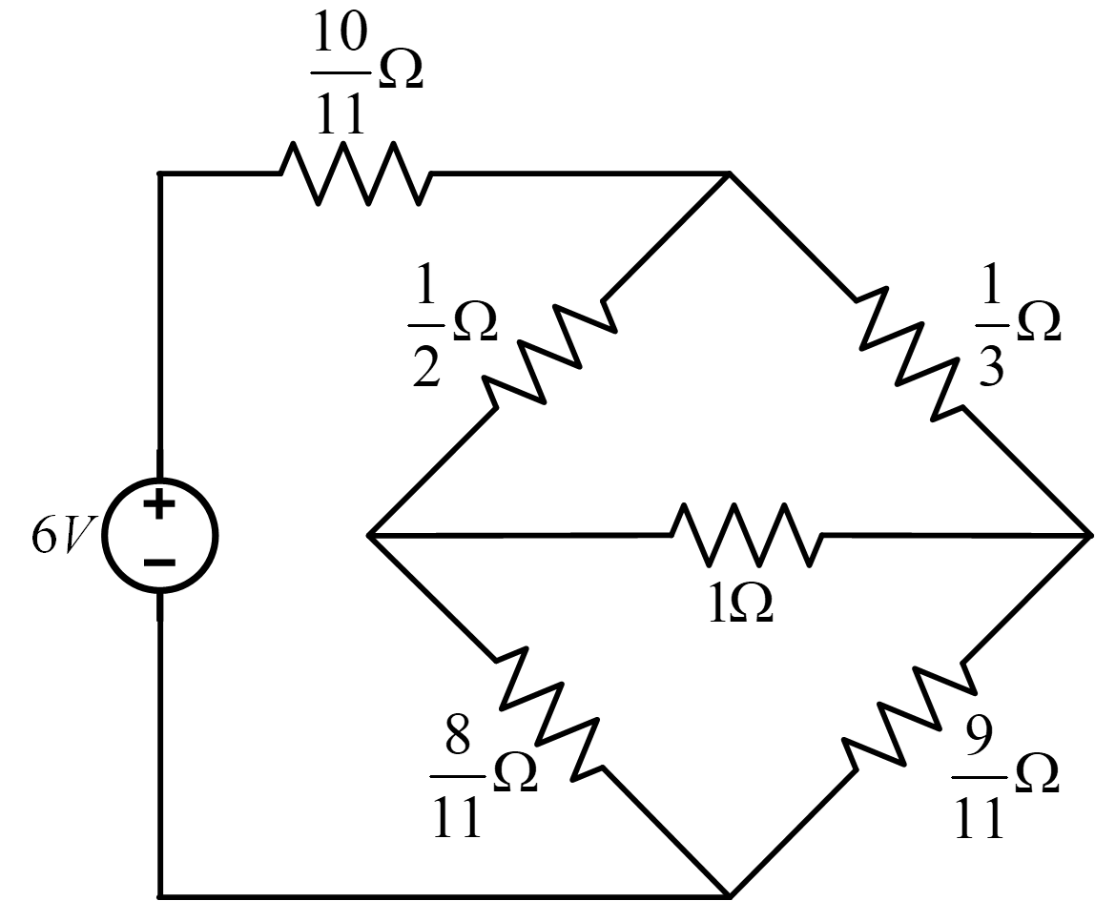
1.Please determine the power supplied by the voltage source in Fig. 1.

Slide 2
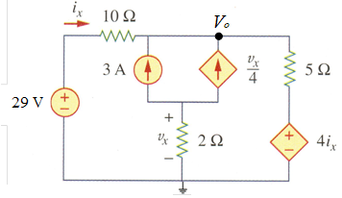
2.Please find V_{o} in Fig. 2.
①
②
①②

Slide 3
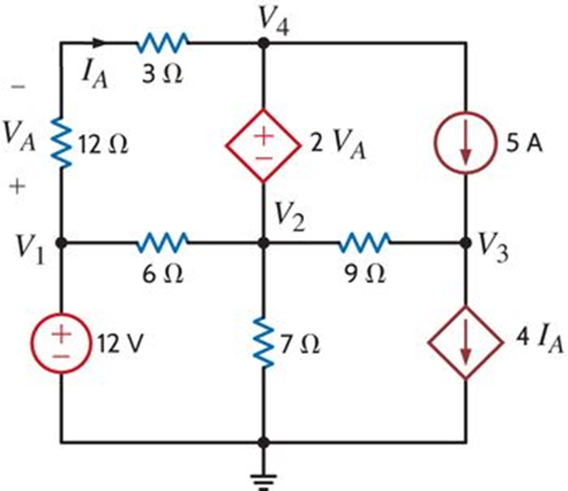
3.Please determine the node voltages defined in Fig. 3.
①
②
聯立①②③可得:
③

Slide 4
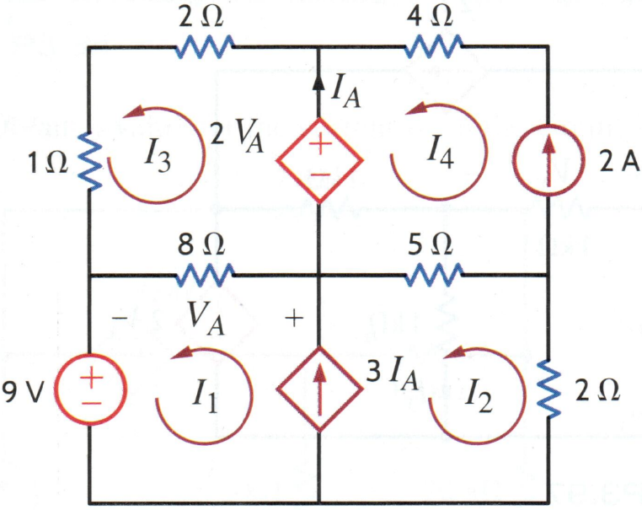
4. (20%) Please determine the mesh currents defined in Fig.
①
KVL：
②
KVL：
③
聯立方程①②③可以得到：

Slide 5
5.(20%) Please determine Vo in Fig. 5.
①
②

Slide 6
6. (20%) (a) Please find V1 in Fig. 6. (5%)
(b) Please find Vo in terms of Vi. (5%)
(c) If the op-amp power supplies are ±16V, what is the allowable range of Vi without
saturation region? (10%)
（c）令
又

